Slide 1
Material Sharing @2 July 2019
Jerry Chang

Slide 2
Outline
OCP Signals Description
Examples of Timing waveform (TBD)
Developers Guidelines

Slide 3
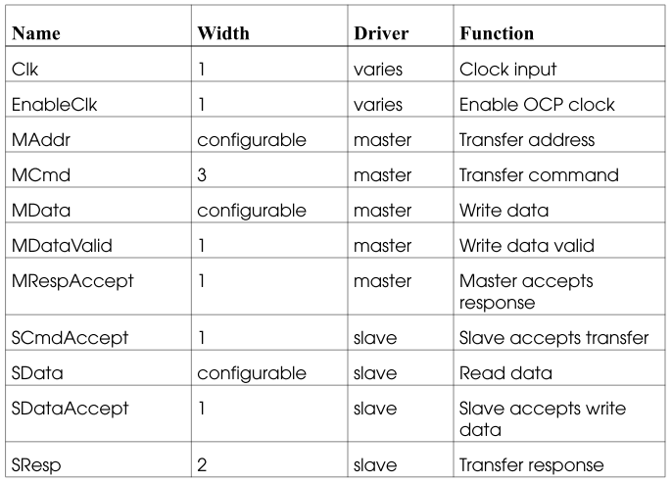
1. Basic OCP Signals
Notes:
Clk: Clock source, positive edge trigger, defined in spec.
EnableClk: Clock enable signal
Maddr: Address for transfer, unit: bytes
MCmd: R/W command, defined in the next slides
Mdata: Write data
MDataValid: valid signal from Master to Slave, active high
MRespAccept: Master responses to slave that the transfer are accepted.
SCmdAccept: Slave responses to master that the transfer are accepted.
Sdata: Read data from Slave to Master
SDataAccept: Slave accepts write data.
SResp: Response from slave to Master.

Slide 4
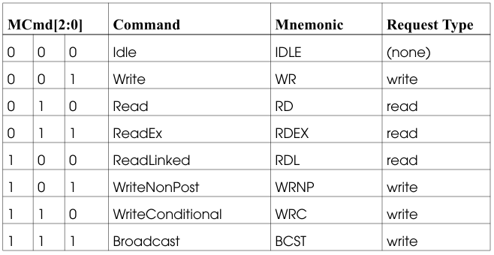
Transfer Command (MCmd)
Notes:
TBD

Slide 5
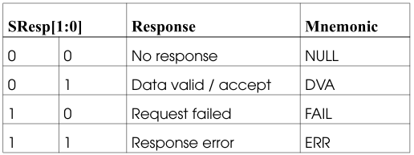
Response (SResp)
Notes:
TBD

Slide 6
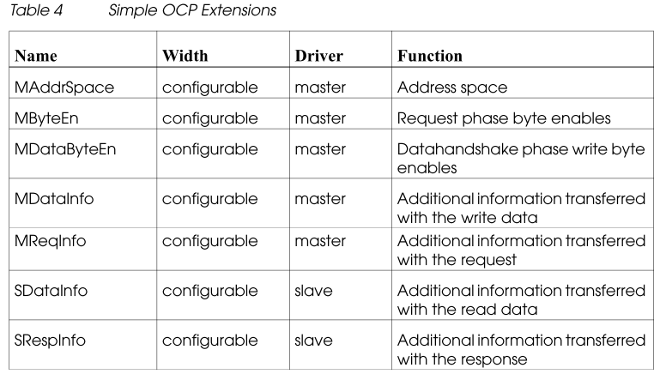
2. Simple OCP Extensions
TBD, no timing waveform for these filed to easily understand.

Slide 7
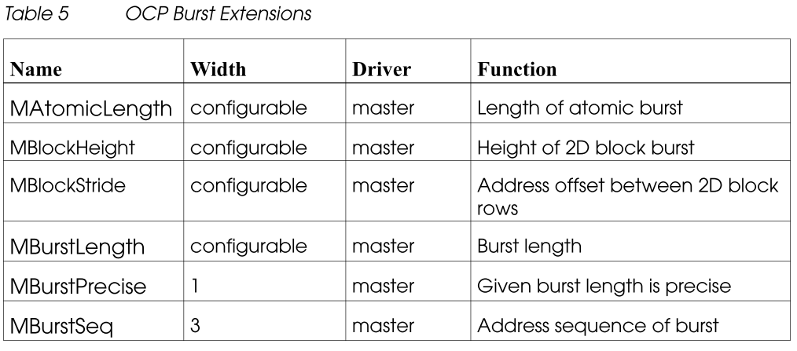
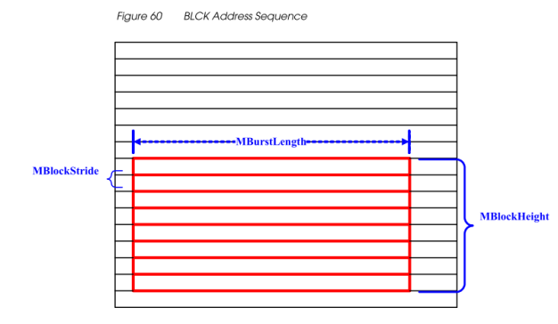
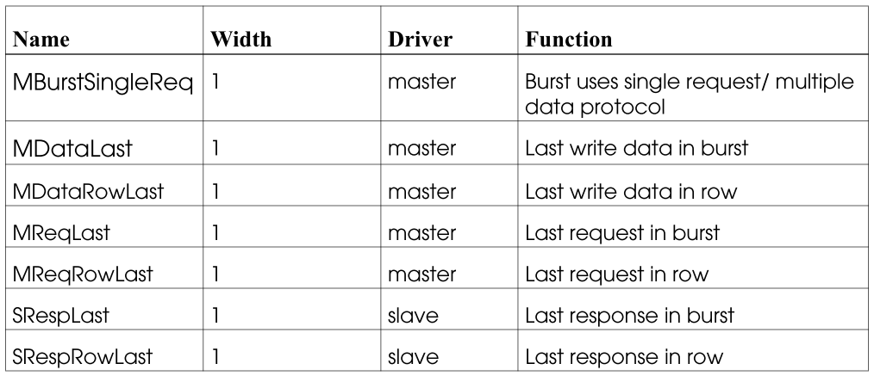
3. Burst Extensions
Notes:
MAtomicLength : The minimal length for a transition which can not be divided. → a signals from Master?
MBlockHeight: #Row
MBlockStride: Address offset for each row in picture.
MBurstLength: #raw_data in a row.
MBurstPrecise: When set to 1, MBurstLength indicates that the precise length of the burst during the first request of the burst.
MBurstSeq: Burst types
MBurstSingleReq: Singal/Multiple protocal
MdataLast: Last write data
MDataRowLast: Last data in row when MBurstSeq = BLCK
MReqLast: Last request in burst
MReqRowLast: Last request in row when MBurstSeq = BLCK
SRespLast: Last response in burst
SRespRowLast: Last response in row when MBurstSeq = BLCK

Slide 8
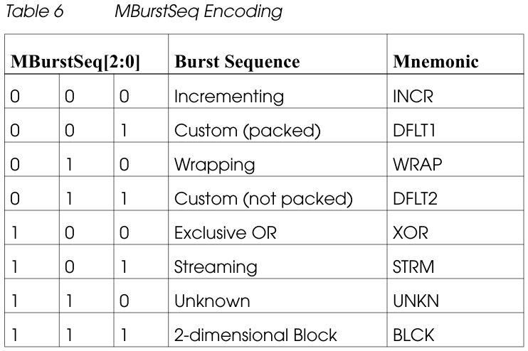
Burst Sequence types
*
*
*
DFLT1, DFLT2, STRM, XOR, and UNKN are need to clarify

Slide 9
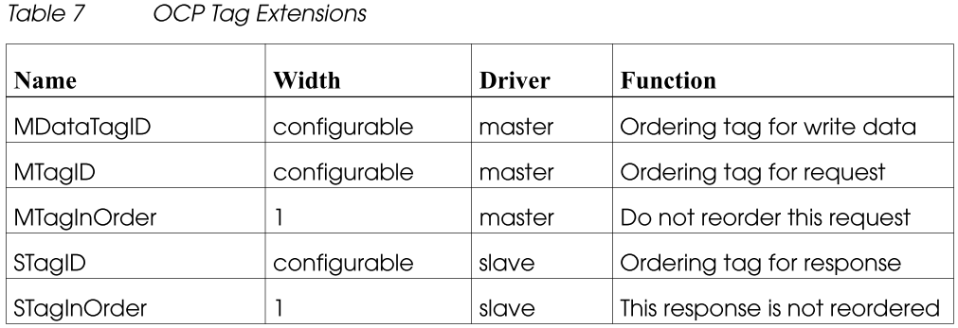
4. Tag Extensions
Tag extensions are added to support the transfer which has out-of-order responses and write data commit.
Notes:
用來排序responses 當transfer 為out-of-order時
MDataTagID: Ordering tag for write data
MTagID: Ordering tag for request
MTagInOrder: Allow slave to reorder the response. i.e., Slave can decide when to response the transfer without ordering.
STagID: Reponses the ordering from Master.
STagInOrder: Active high in response for MTagInOrder = 1 (means they have ordering responses)

Slide 10
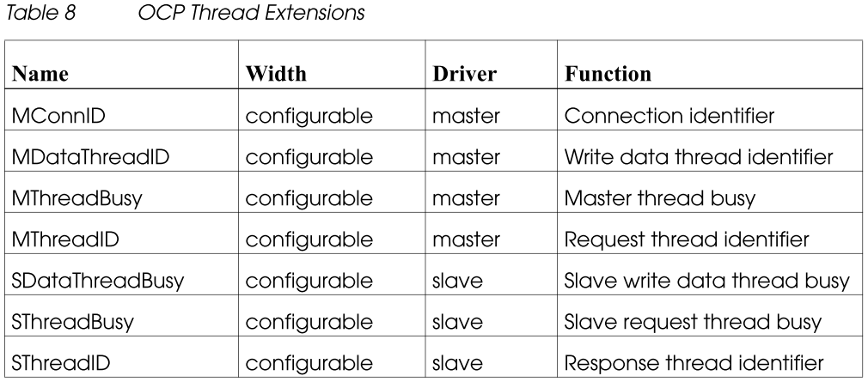
Thread Extensions
Notes:
MConnID: Connection Identifier from Master. The usage OCP book gives an example for security in 15.1.15
MDataThreadID: Write data thread id. This variable-width field provides the thread identifier associated with the current write data
MThreadBusy: Master thread busy.
MThreadID:
SDataThreadBusy:
SThreadBusy:
SThreadID:

Slide 11
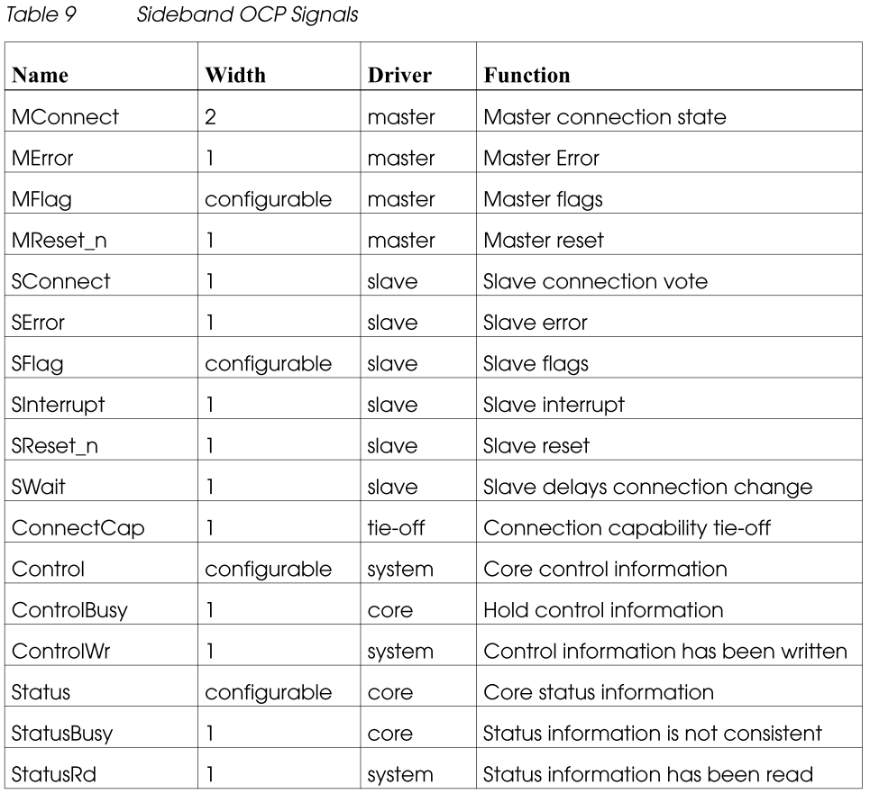
SideBand Signals

Slide 12
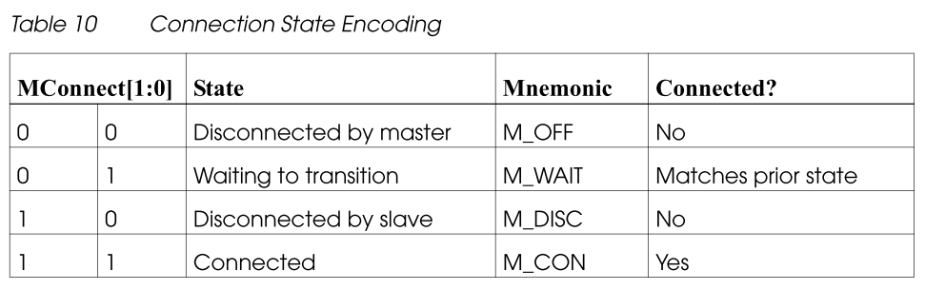
SideBand Signals

Slide 13
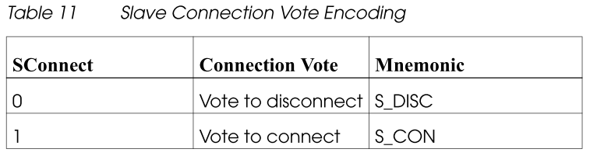

Slide 14
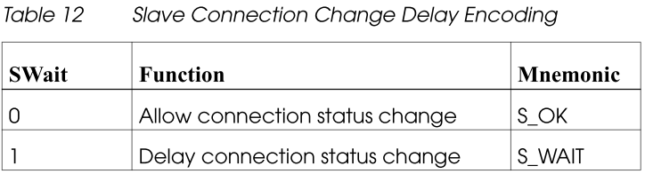
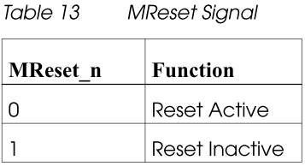

Slide 15
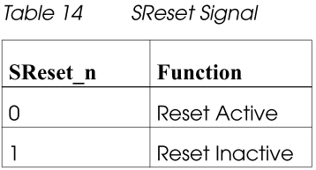

Slide 16
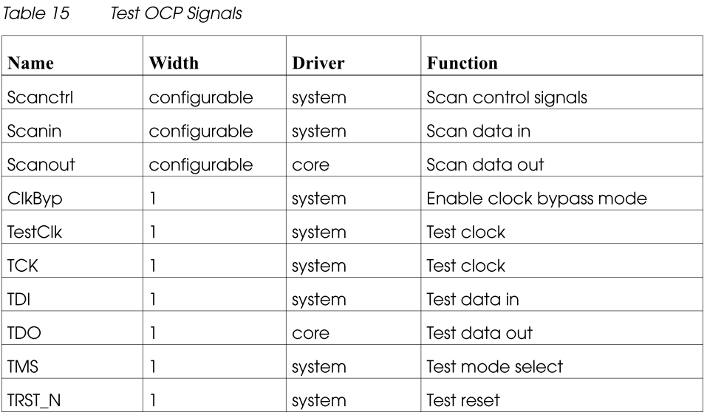

Slide 17
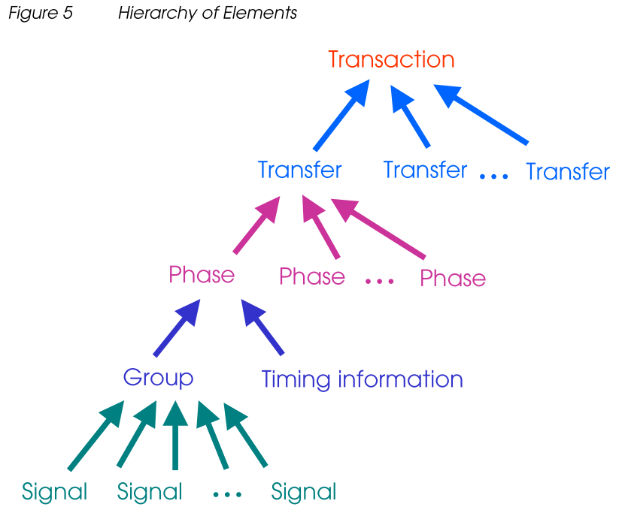
Hier. of Trans.
Request/Response phase
Like AMBA: Address/Data phase etc.
Request, Response, Datahandshake ←
→Timing waveform
for difference cases
→ Maddr, MCmd, and so on

Slide 18
Examples of Timing waveform (TBD)

Slide 19
Developers Guidelines
Divided Clocks
Signal Timing

Slide 20
OCP Clocks
Capture at Rising edge
No assertions about the duty cycle
Divided Clocks
EnableClk provides flexible support for multi-rate systems. When set with the enableclk parameter, the EnableClk signal provides a sampling signal that specifies which rising edges of the Clk signal are rising edges of the OCP clock.
12.1.1.1 gives an instance for divided clocks with EnableClk.

Slide 21
Signal Timing
Three Phases
Request Phase
Response Phase
Datahandshake Phase

Slide 22
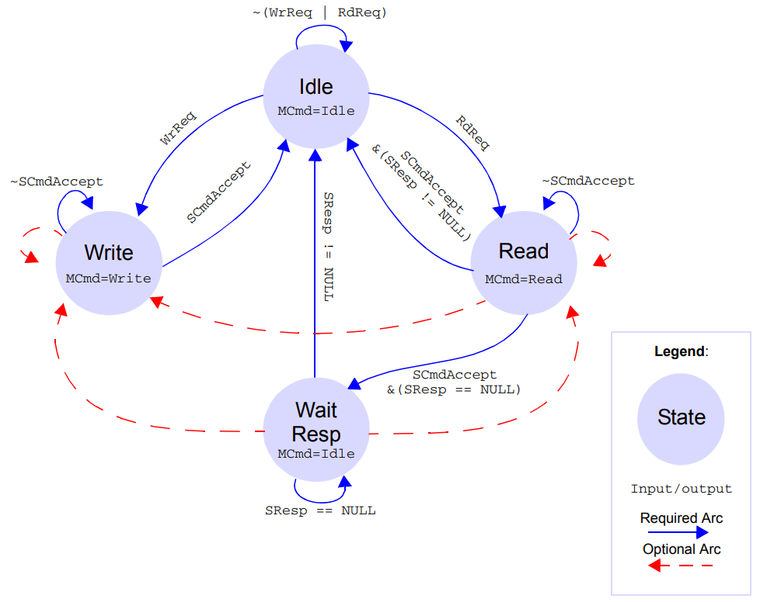
Example of Sequential Master
Required Arc
Original path for Read/Write requests
Optional Arc
For throughput improvement

Slide 23
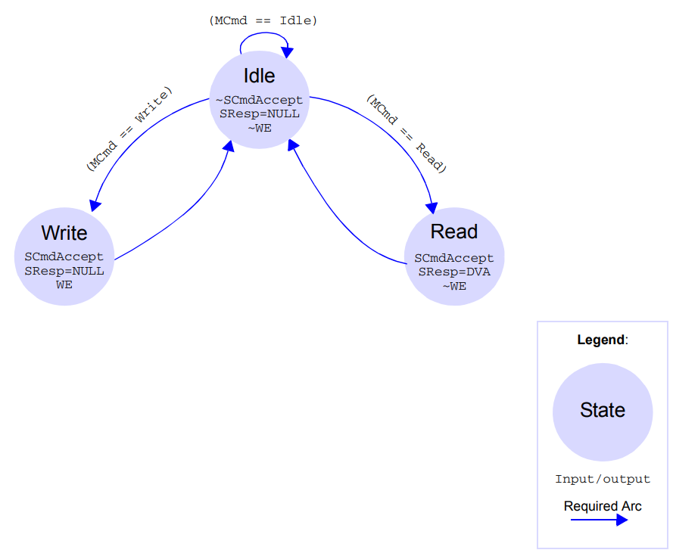
Example of Sequential Slave

Slide 24
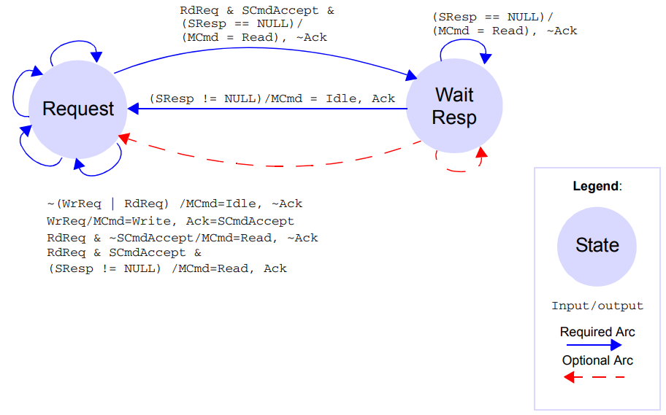
Example of Combinational Master

Slide 25
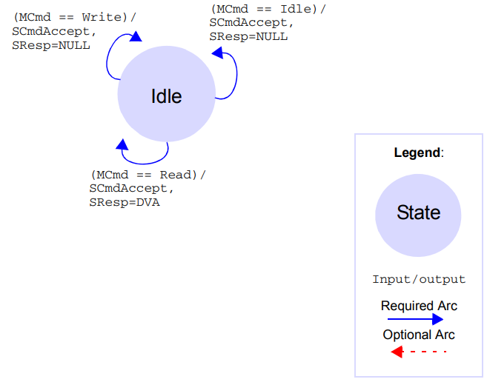
Example of Combinational Slave

Slide 26
Study at pp.227 burst transfers.

Slide 27
CACHE Related Knowledge

Slide 28
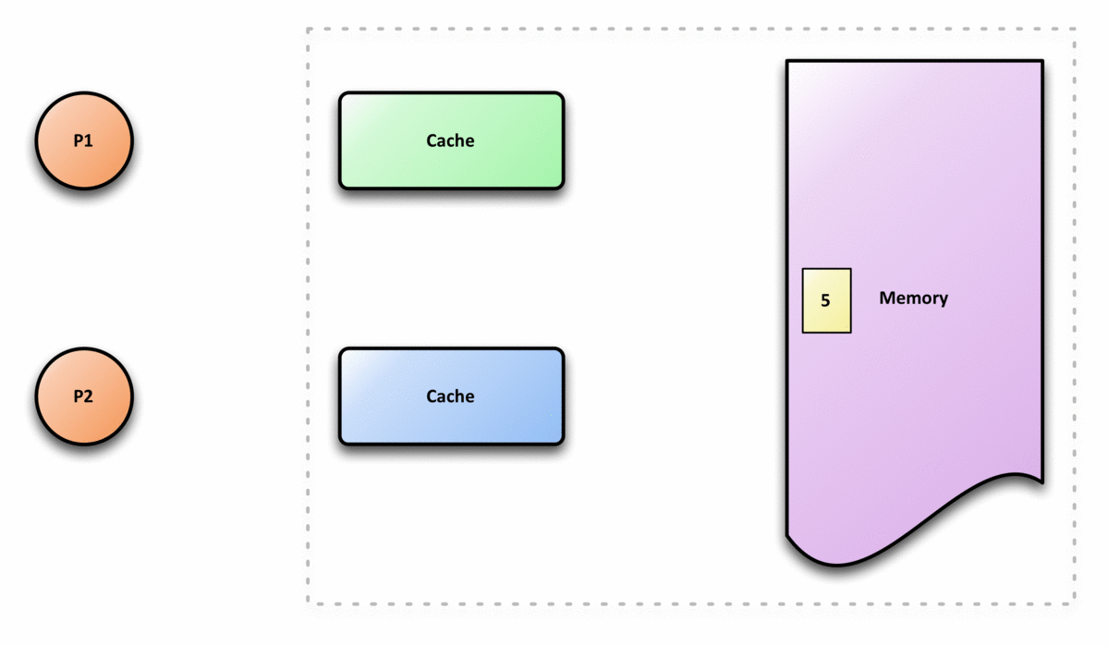

Cache coherence
https://zh.wikipedia.org/wiki/%E5%BF%AB%E5%8F%96%E4%B8%80%E8%87%B4%E6%80%A7

Slide 29
Material Sharing @3 July 2019
Jerry Chang

Slide 30
Descriptions for some BUS-related words
https://codertw.com/%E7%A8%8B%E5%BC%8F%E8%AA%9E%E8%A8%80/532466/
MMR: memory mapped register

Slide 31
Outstanding
如果outstanding能力为N>1的话，则：
读操作：可以连续发N个读地址命令，这期间如果读数据没有返回，则需要需要等待读数据返回，如果有读数据返回，则返回了几个，那么仍然可以接着发几个。也就是说，“在路上” 的读命令（或者读数据）最多可以是N。多说一点，可以看出，如果数据返回得比较慢，那么IP需要等待，效率就会比较低，因此，为了提高效率，有必要提高outstanding能力，以弥补”路上“（总线）引入的延时。但是也不能无限制地发，有可能会引起总线拥塞，把其他IP给堵住。
写操作：可以连续发出N组写地址（写数据）命令，这期间如果写响应没有返回，则必须等待写响应返回才能接着发写地址（写数据）命令，如果有写响应返回，则返回了几个，那么仍然可以接着发几组。也就是说，“在路上” 的写响应最多可以是N。

Slide 32
Cacheable
Cacheable說的是進行讀寫的時候要去cache里查看（noncacheable就是不用去cache里查看，直接送往memory）。在AXI4的協議裡面，cacheable改成了另外modifiable，還有兩個特性就是read prefetch和write merge

Slide 33
Buffable
Bufferable意思是說不必把結果寫進最終目的地而只是寫進中間某個buffer就可以回response，而non-bufferable則是把結果要寫進最終的目的地才能回response。non-bufferable一般用於device的讀寫，也就是SOC里講的MMR

Slide 34
Material Sharing @4 July 2019
Jerry Chang

Slide 35
Outline
Architecture
Flow

Slide 36
Architecture
Test-Access Port (TAP) Controller
JTAG
Data Register/Instruction Register (IR/DR)
WTAP Controller
MBIST Controller

Slide 37
Test-Access Port (TAP) Controller
Receive/Send command/information by JTAG
Data Register/Instruction Register (IR/DR)

Slide 38
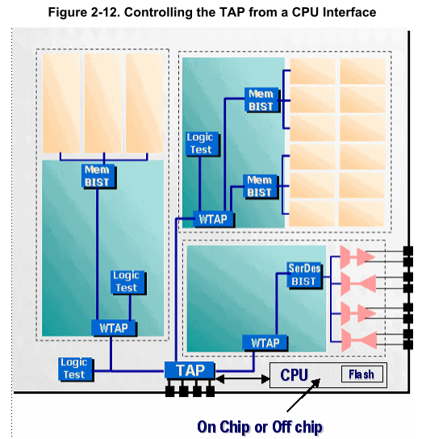
No discuss CPU

Slide 39
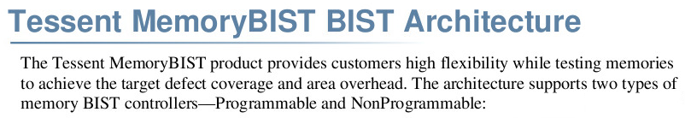
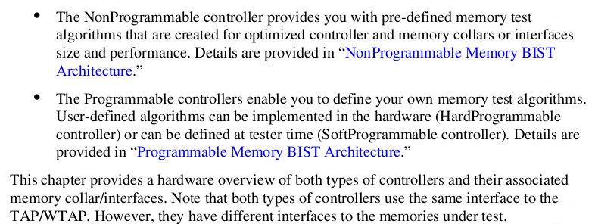
We use it, no customized.

Slide 40
TAP controller

Slide 41
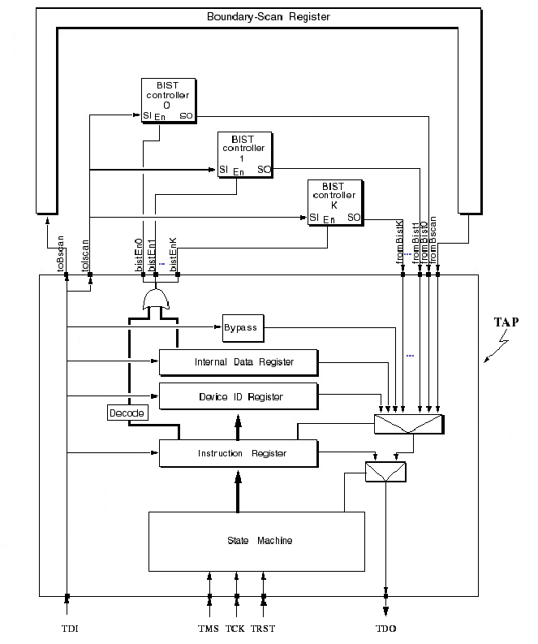

Slide 42
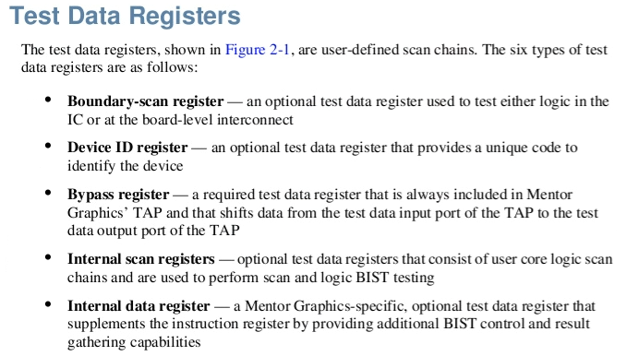
Data register

Slide 43
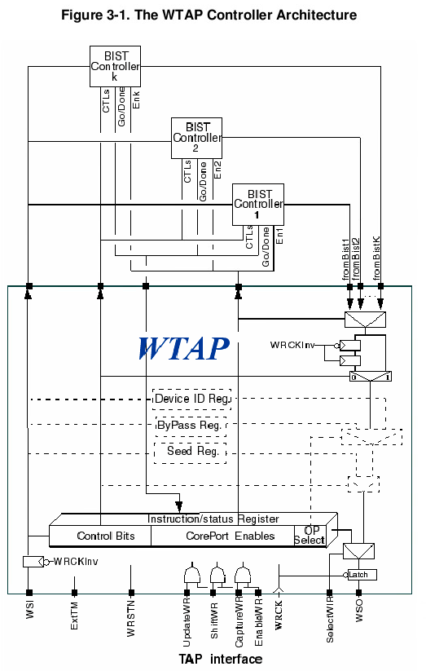

Slide 44
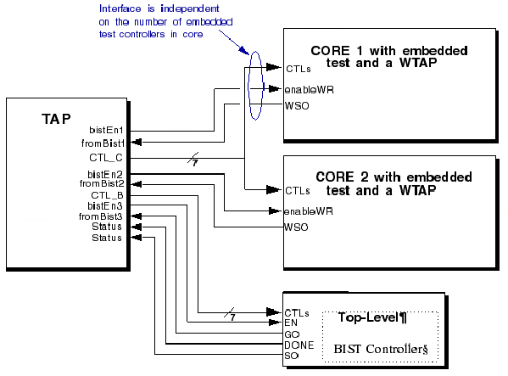

Slide 45
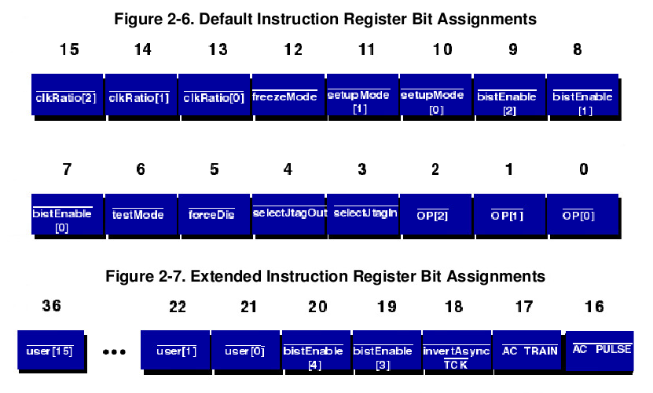
TAP IR Format

Slide 46
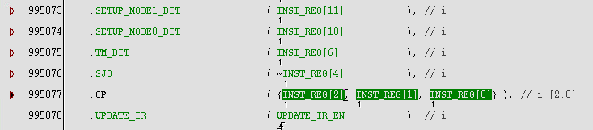
Only used in boundary scan,
no discussed in this slice.
No used in our design

Slide 47
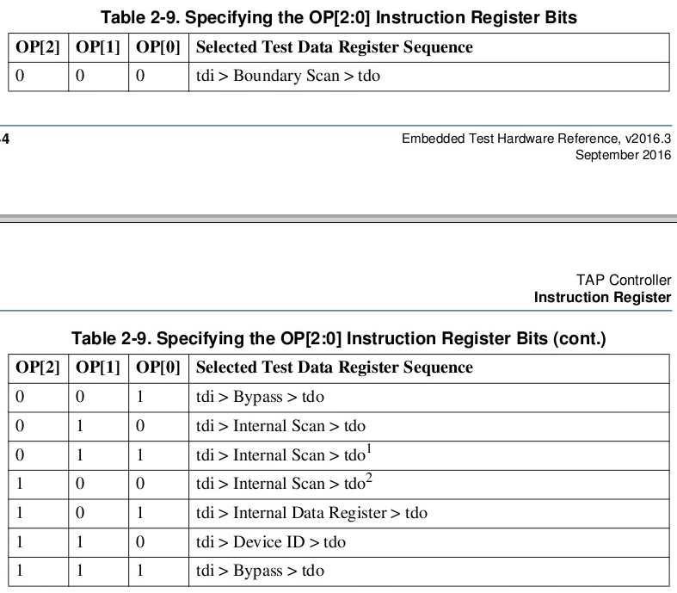
This values select a test data register
In our code, it only with only MBIST=ON
The code only has these two signals
No used
Hold BIST

Slide 48
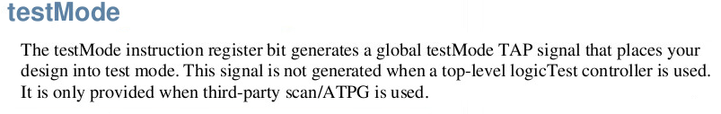
In out MBIST, this bit drive to multiEn0
But multiEn0 has no any loading signals

Slide 49
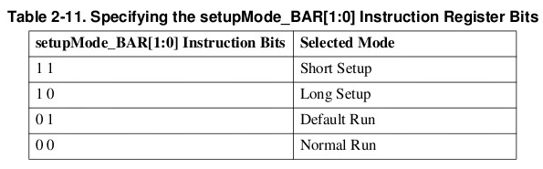
MBIST mode runs at normal run, it sets Bit10 = 0

Slide 50
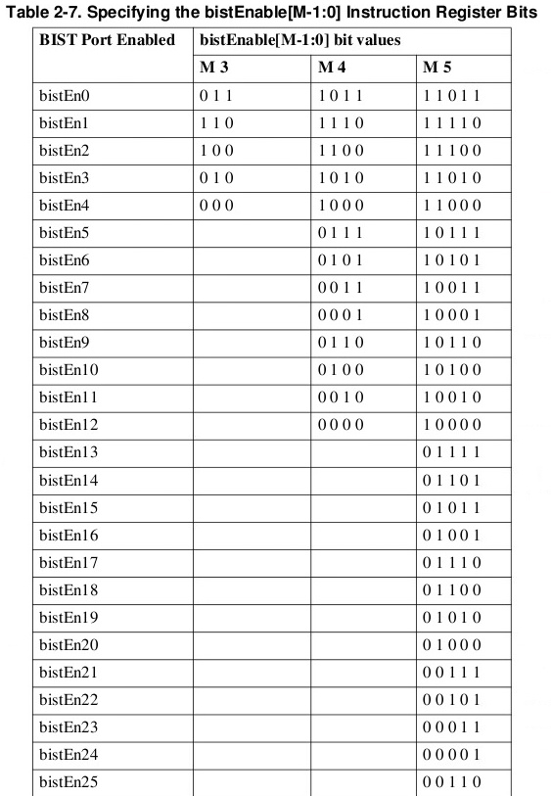
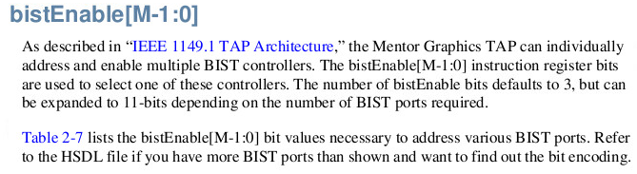
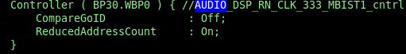
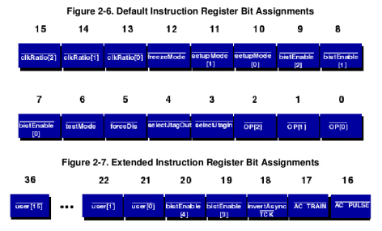
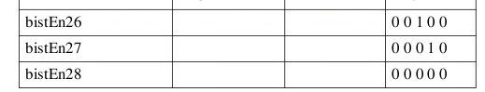
The corresponding enable controller, you can refer to the.
This file illustrate the enable bit for each MBIST controller.

Slide 51
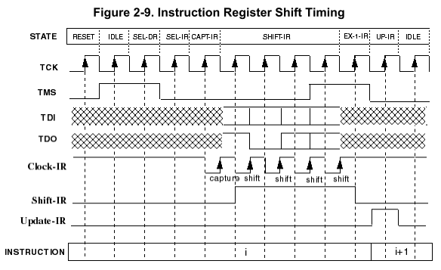

Slide 52
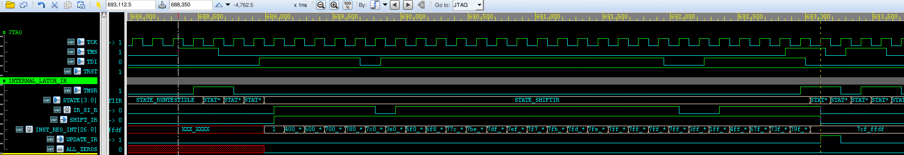
Example from JTAG to IR
Enter SHIFTIR(JTAG)
Shift to IR
Capture IR

Slide 53
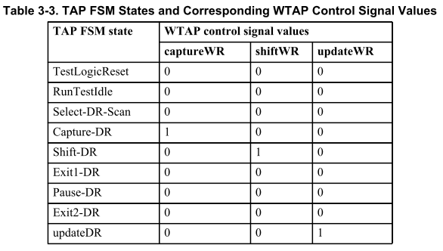

Slide 54
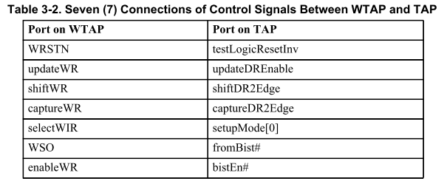

Slide 55
Referenced Flow for MBIST Pattern (TBD)
Write TAP IR
Enable bit & normal mode
Write WTAP WR
Set WTAP IR setupMode[2:0] to “normal run.”
If ENABLE is active, it will trigger MBIST_GO signal
Read WTAP WR
Check Go and Done states.
IF ROM, Read WTAP WR
Check MISR
Notes:
需要補上WTAP的IR說明

Slide 56
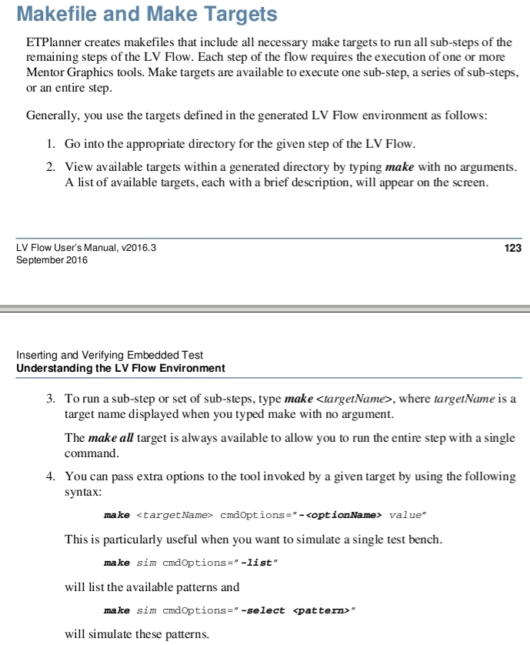

Slide 57
VCS
If you meet some VCS simulation env. Problem
Delete *.dir & csrc to recompile whole design

Slide 58
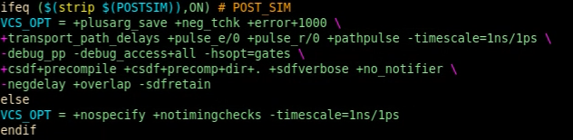
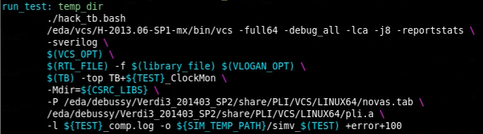
VCS option example

Slide 59
Makefile Function
https://wiki.ubuntu.org.cn/%E8%B7%9F%E6%88%91%E4%B8%80%E8%B5%B7%E5%86%99Makefile:%E4%BD%BF%E7%94%A8%E5%87%BD%E6%95%B0

Slide 60
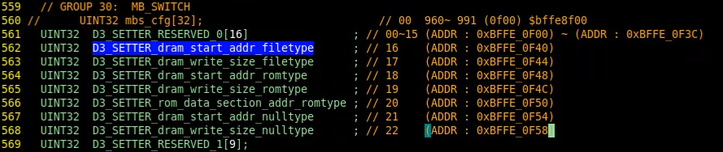
DDR III Setter Reg. Spec.

Slide 61
UVM Study @11 Nov 2019
Jerry Chang

Slide 62
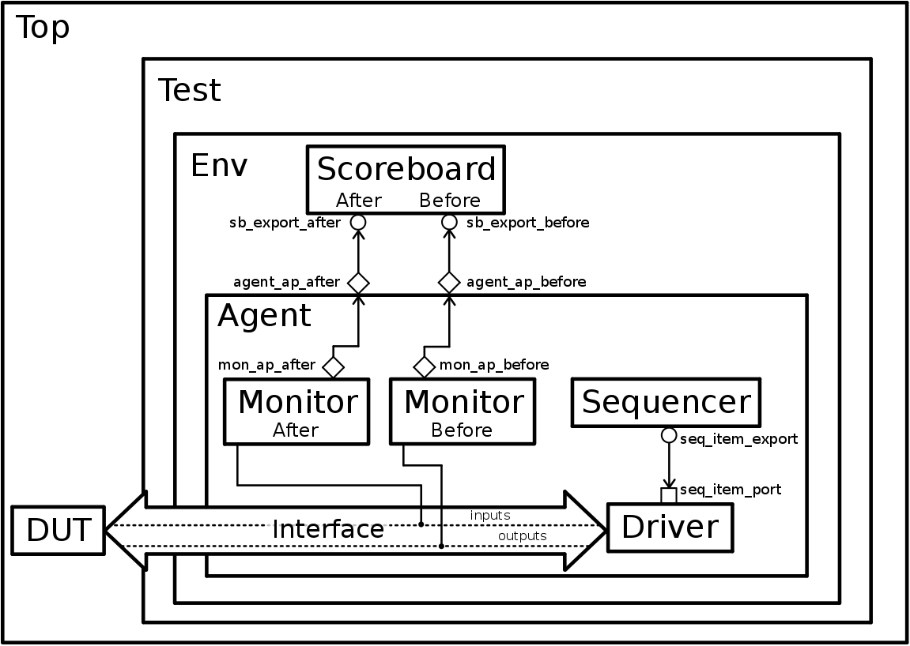
UVM Structure
Notes:
1） 正如這個圖片所展示的，UVM是除了DUT（待驗證模塊）的其他所有部分。其中，sequencer產生sequence（圖上沒畫），sequence產生transaction。
transaction，類似於軟件中的一個package。在硬件中，以一個transaction為單位進行傳輸，一個完整的transaction傳輸結束，才拉高或拉低電平。
2）通過UVM的專門的類型——port把數據給driver。driver通過interface把產生的激勵（也就是transaction）輸入DUT。同時，DUT的輸出也是和interface相連接的。一個monitor（monitor after）監測driver吐給DUT的輸入，一個monitor（monitor before）監測DUT吐出來的輸出。
3） 這裏，看到一個agent把整個monitor、sequencer、driver都裝起來了。這個agent實現的功能是轉換。因為整個UVM都是systemverilog的，並且理論上是仿真的，都不是“硬件”。DUT在這裏是真正的“硬件”。兩者之間不能直接通信，只能通過一個agent，來對協議進行轉換。不過，我們可以不用管agent怎麽實現的。在開發的時候，只要把相關的模塊連接好就行了。
4）這個圖還少了一個reference model。因為reference model的工作在這個例子中，實際是在monitor after裏面實現的。- -不過沒關系。reference model完成的工作是，把DUT做的事完全的再做一遍。reference model接入monitor采到的輸入激勵，按照DUT的邏輯，產生一個結果。
5）同樣通過port，把reference model產生的結果同monitor before采到的數據都丟到scoreboard上。在scoreboard上，我們會對兩個結果進行比較。如果兩個結果一致，則為正確。如果不一致，則為錯誤。
UVM本身用700頁來寫也完全可以。因為UVM極其復雜。本文不在此贅述。

Slide 63
Feed Forward Equalization (FFE) @10 Mar. 2020
Jerry Chang

Slide 64
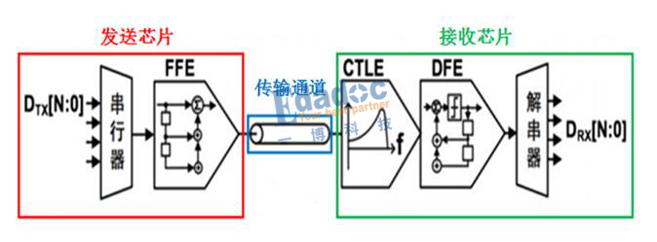

Transmission channel can be seen as an low-pass filter. Therefore, pre-emphasis is used to compensate the high-frequency parts to keeps original low/high voltage.
The pre-emphasis can be implemented by a N-tap high-pass FIR. Like the following figure.
https://www.itread01.com/content/1533891877.html

Slide 65

PrimeTime – InspectView

Slide 66
SpyGlass AIPK Study @16 June. 2020
Jerry Chang

Slide 67


Slide 68


Slide 69

FPGA synthesis Problem
Problem Pins
QTH_U2PHY[87] → UTMI_CLK
DRC Error
[Place 30-574] Poor placement for routing between an IO pins.
Message
This is caused by QTH_U2PHY[87] is not a CCIO, so it can not directly to connect to clock backbone.
Set_property CLOCK_DEDICATED_ROUTE FALSE can waive this DRC.

Slide 70


Slide 71


Slide 72

Coverage Group
Identify the functional coverage via defining coverage group
coverpoint: a group of pins
cross: cross coverage condition
Functional Coverage
Variable
Cross
Notes:
http://www.asic-world.com/systemverilog/coverage19.html

Slide 73

Example
Covergroup
addr = {0,1,2,3}
Cmd={0,1,2}
Cross ADDR, CMD
Execution
Rand [0-5] for addr
Rand [0-2] for cmd

Slide 74

Execution
Covergroup
addr = {0,1,2,3}
cmd={0,1,2}
Cross ADDR, CMD
Execution
addr = { 0,1,2,4,5}
cmd = {0,2}
Result shows that addr= 3 and cmd = 1 not trigger.
Functional Coverage
Variable Coverage
(# Execution.addr + # Execution.cmd)/(#covergroup.addr + #covergroup.cmd)
= (3+2)/(4+3) = 5/8 = 67.5%
Cross Coverage
4/(4*3) = 4/12 = 33.3%
0 1 2 3
0 1 2

Slide 75

Randomize and shuffle
http://www.dvagent.com/forum.php?mod=viewthread&tid=160
Randomize: class 內 randc 隨機化
Shuffle: variable 洗牌隨機化

